Slide 1
www.bonitabridge.org
info@bonitabridge.org
(239) 221-7781

Slide 2
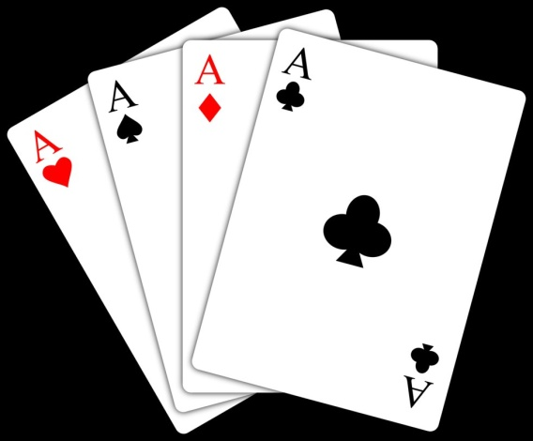
Bergen Raises
Jon Mercurio
Bonita Bridge Club

Slide 3
What are Bergen Raises?
A different way of showing 4-card support!
Based on Larry Cohen/Marty Bergen Law of Total Tricks (LOTT)
LOTT was popularized by Larry Cohen's 1994 “To Bid or Not To Bid”
In the world of Bridge we have laws and rules:
Rules are inviolable regulations (stuff that generally requires the intervention of the director)
Laws are “rules” of thumb – guidelines that require common sense in their application. LOTT is just that – a rule of thumb that works most of the time.

Slide 4
What is “The Law”?
Law of Total Tricks – Briefly the “Law” says:
In a competitive auction your side can take as many tricks as the number of total trump held by your side. First, in a non-competitive auction
Example 1: Bidding goes 1♠ - P – 2♠ (without competition, so far)
Nominally the 2♠ bid promises 3-card support, opener has 5-card suit, so...You have 8 total trump, and you should be able to win 8 tricks – the 2 level. Responder has minimum hand, with no extras no reason to continue!

Slide 5
What is “The Law”?
Law of Total Tricks – Briefly the “Law” says:
Again in a non competitive auction :
Example 2: Bidding goes 1♠ - P – 3♠
You have 4 card support & 10+ HCP, your limit raise to 3♠ promises 4-card support, but you also have at least 9 trump = 9 tricks → the 3-level.
What Bergen/Cohen discovered is that holding 9 trump was a more important indicator of a safe level than the holding of the suggested 22 HCP.

Slide 6
Convert the LOTT Logic
1. Partner opens a Major suit promising 5-Cards
2. You have 4-card support – you would like to tell partner that fact, but...
you can only do it if you have 10+ playing points
a) 10-12 → Limit Raise (showing 4-card support) b) 13+ → Jacoby Trump raise
What if you have 1) 6-9 points?
2) < 6 points?
3) Singleton or void?

Slide 7
Converting the LOTT Logic
What if you have 1) 6-9 points
A) Singleton or void makes your hand stronger than the HCP you hold.
B) If your RHO passed, LHO might have a decent hand and may want to bid even if you bid at 2 level.
Importantly -it is here where the preemptive nature of the Bergen raise comes into play
2) < 6 points?
3) Singleton or void?
The “LAW” says you can be at the 3-level so... why not use the law to perhaps shut out a bid by your LHO

Slide 8
The Basics of Bergen Raises
If Partner opens a Major and you have 4-card support, LOTT says you can compete to the 3-level regardless of point count. Forcing LHO to bid at 3-level to compete is similar to what an opening preemptive bid does.
So we need to 'invent' 3-level bids that shows 4-card support and also tells partner how many points we hold.

Slide 9
The Basics of Bergen Raises
Opener: 1 of a Major... followed by a pass!
← important
Responder: (with 4-card support) bids:
3♣ - showing 6-9 points 3♦ - showing 10-12 points (the limit raise) 3 of Partners Major – showing < 6 points (weak jump) 3 of other Major - Anonymous Splinter 2NT – Jacoby Raise shows 13+
These are Conventional bids – therefore they are ALERTABLE
With any of these bids the responder has fully described a hand with 4-card support in just one bid – and is fully “protected” by “THE LAW”

Slide 10
The Basics of Bergen Raises
There is a nemonic to aid in remembering the meanings of the BERGEN RAISES (always a 4-card suit):
CLAP – C is for Constructive 3♣ - showing 6-9 points L is for Limit 3♦ - showing 10-12 points A is for Anonymous P is for Pre-Emptive The weak jump
Constructive raises say: “I have some help but the heavy lifting is up to you”. In this case you have the 4 trump cards but few points.

Slide 11
The Basics of Bergen Raises A is for Anonymous
We all know what Splinter bids show: 1. Singleton or void and 4+card support and 2. Invitational hand+ (10-12 HCP) 13+ playing points
enough to be in game
The difference is that regular Splinter bids show: - Singleton or void in the bid suit.
- Anonymous Splinter does not tell the suit it says: I have shortness somewhere
Ex: 1 ♥ – P – 4♣
Ex: 1 ♥ – P – 3♠

Slide 12
The Basics of Bergen Raises Finishing Touches
After anonymous splinter 3NT asks for short suit! Note: 3NT is not “to play” it is part of the Bergen Raise.
Can we use Bergen raises if RHO interferes? NO!! If there is an intervening bid we have different methods !
After interference responder has a choice of 3 bids:
A bid of any suit except overcalled suit is natural
Cue bid - - Repeating overcalled suit is Limit Raise (3+Card)
Overcall is a Take-out Double – There's Jordan

Slide 13
The Basics of Bergen Raises Finishing Touches
After interference responder has a choice of 3 bids: A bid of any suit except overcalled suit is natural Cue bidding overcalled suit is Limit Raise (3+Card)
Example: Partner Opens 1 ♥ and RHO overcalls 1♠
A response of 2♠ → promises 10-12 pts and at least 3♥'s 2 ♣ or 2♦ - shows 10+ points and a real (5-card) suit* and
2♥ is the old-fashion 6-9 pt 3+card support.
* This is a BOP bid

Slide 14
The Basics of Bergen Raises Finishing Touches
After interference responder has a choice of 3 bids: A bid of any suit except overcalled suit is natural Cue bidding overcalled suit is Limit Raise (3+Card)
Example: Partner Opens 1♠ and RHO overcalls 2 ♥
A response of 3 ♥ → promises 10-12 pts and exactly 3♠'s 3 ♣ or 3♦ - shows 10+ points and a real (5-card) suit and
2♠ is the standard 6-9 pt & 3+card support.

Slide 15
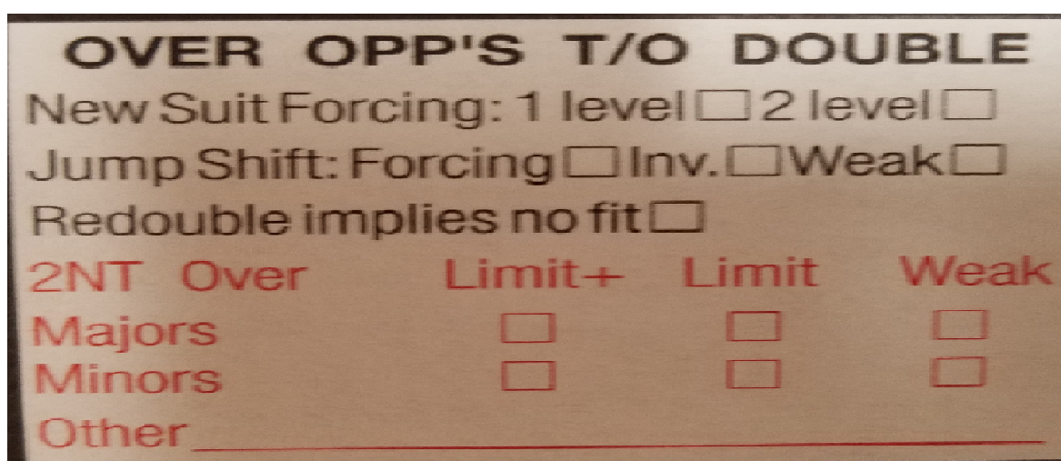
The Basics of Bergen Raises Finishing Touches
After interference responder has a choice of 3 bids:
Overcall is a Take-out Double – There's
Jordan
Jordan

Slide 16
The Basics of Bergen Raises Finishing Touches
Jordan
New suit forcing → we have balance of power, contract should be ours, we should compete & I have a suit
Jump shift → partnership agreement
Redouble implies no fit but shows balance of power with no suit. Generally implies 10+ HCP
2NT – The essence of Jordan - - can show a variety of hands as shown in the check boxes. Requires partnership agreement. Most players use Limit or Limit+ & 3-card support.

Slide 17
CONCLUSION
Simple change to your conventional bids
Easy to master
Combined with Jacoby 2NT and Jordan, Bergen raises provide a means for responder to show practically any sort of hand with just one bid – that's a powerful addition to your bidding repertoire.

Slide 18
Bergen Raise
Opener: 1 of a Major... followed by a pass!
Responder: (with 4-card support) bids:
3♣ - shows 6-9 points (weak raise) 3♦ - shows 10-12 points (the limit raise) 3 of Partners Major – shows < 6 points (weak jump) 3 of other Major - Anonymous Splinter
Some players interchange the meaning of the minor suit responses –> Reverse Bergen

Slide 19
Questions?

Slide 20
Next Lesson

